Slide 1
“PRINCIPLES OF PERSUASIVE SPEECH”
Communication and Presentation Skills
Department of Computer Science
FAST NU Peshawar
Lecture by Ms. Maryam Ali Khan

Slide 2
Ever imagined yourself giving such a stirring speech that the audience cheered wildly at your persuasive powers?
  It works well in fantasies but the real-life attempts to persuade are not always successful!

Slide 3
Persuasive speaking, a process in which a speaker presents a message intended to affect an audience in a way that is likely to reinforce a belief, or move an audience to act, is perhaps the most demanding speech challenge

Slide 4
PRINCIPLES OF PERSUASIVE SPEAKING
Writing a Specific Goal
Adapting to Audience Attitude
Giving Good Reasons and Evidence
Organizing Reasons to Meet Audience Attitudes
Motivation
Building Credibility
Gender and Cultural Differences
Presentation

Slide 5
1. WRITING A SPECIFIC GOAL
Principle 1: You are more likely to persuade an audience when you can articulate specifically what you want your audience to believe or do.
Persuasive speech is designed to:
  Establish beliefs
  Change beliefs
  Move to action

Slide 6
HOW TO ESTABLISH OR CHANGE BELIEFS?
The following statements are written to seek audience acceptance of your belief:
  I want the audience to believe that the city should build a downtown entertainment center.
  I want to audience to believe that small schools are better for insecure students than are large schools.
  I want the audience to believe that the speed limit on all interstate highways should be raised to seventy miles per hour.

Slide 7
THINK!
Do you need to advocate what should or ought to be believed?
Or do you need to advocate what the audience members should or ought to do as a result of that belief?

Slide 8
HOW TO MOVE AN AUDIENCE TO ACTION?
I want my audience to donate money to the food-bank drive.
I want the members of my audience to write to their representative to support legislation in favour of gun control
I want my audience members to attend the annual sports gala.

Slide 9
2. ADAPTING TO AUDIENCE ATTITUDE
Principle 2: you are more likely to be able to persuade when you direct your goal and your information to your audience’s attitude.
Attitude: a general or enduring positive or negative feeling about some person, object, or issue.
How do people express their attitudes? Verbally as opinions

Slide 10
ATTITUDE?
OPINION?
Betty says “I think physical fitness is important”
Its an opinion that reflects a favourable attitude about physical fitness.

Slide 11
How your audience will react can determine your success.
Find out where the audience stands
Finding judgments based on demographic information and opinion polls.
The more data you have, the better are your chances of judging audience attitudes.

Slide 12
AUDIENCE ATTITUDE
Audience attitude(expressed by opinion) may be distributed along a continuum from highly favourable to hostile.

Slide 13
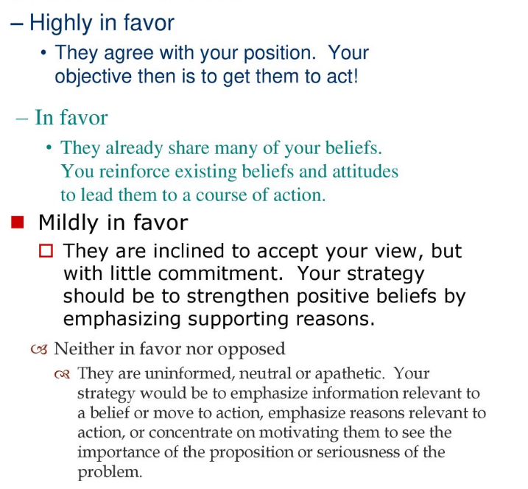

Slide 14
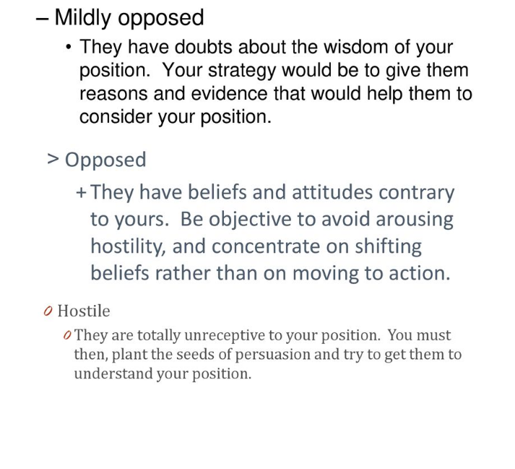

Slide 15
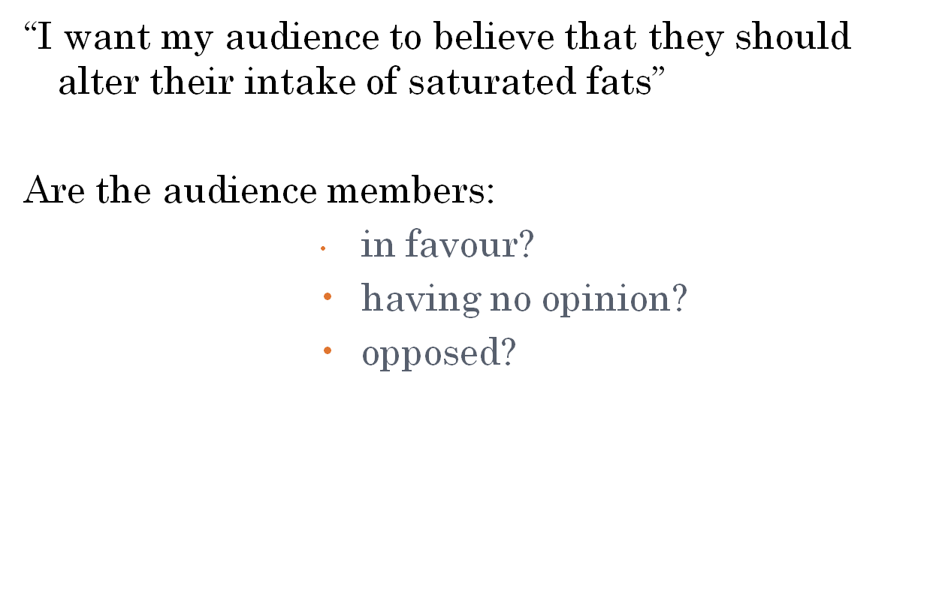
STRATEGIES FOR ADAPTING TO AUDIENCE

Slide 16
STRATEGY FOR AUDIENCE IN FAVOUR
Goal: Focus on specific goal of action
If the members already favour limiting their intake of saturated fats, it would be a mistake to focus on changing their belief.
In this case, what keeps the people from acting or practically implementing this? LACK OF MOTIVATION.
What to do then? Recommit them to a particular direction, or suggest a specific course of action that will serve as a rallying point.

Slide 17
STRATEGY FOR AUDIENCE WITH NO OPINION
Goal: to establish a belief or goals that moves the audience to action.
The audience may have no opinion because they are:
  Uninformed
  Neutral
  apathetic

Slide 18
UNINFORMED AUDIENCE
Strategy: Give enough information before persuasive appeal
Define “saturated fat”, talk about how cholesterol is formed, and share medical evidence about its effects on the body.

Slide 19
NEUTRAL AUDIENCE
Strategy: present the best possible arguments and support them with the best information you can find

Slide 20
APATHETIC AUDIENCE
Strategy: Move them out of apathy.
Members of your audience may know what saturated fat is, know how cholesterol is formed, and even understand the medical information of negative effects, but they may now seem to care.
Focus on your listeners’ personal needs

Slide 21
STRATEGY FOR OPPOSED AUDIENCE
Goal: determine if their attitude is slightly negative or totally hostile

Slide 22
SLIGHTLY OPPOSED AUDIENCE
Strategy: approach directly with your argument
If your audience is slightly opposed to lowering their saturated-fat intake, you can present good reasons and evidence supporting the proposal.

Slide 23
HOSTILE AUDIENCE
Strategy: approach the topic indirectly or to consider a less ambitious goal.
Can you expect a complete shift in attitude or behavior as a result of one speech? Its unrealistic!

Slide 24
PERSUADING THE HOSTILE AUDIENCE
Present a modest proposal that seeks a slight change in attitude ( you may be able to get an audience to at least consider the value of your message)
Ask for a greater change slowly when the idea begins to flow.

Slide 25
GIVING GOOD REASONS AND EVIDENCE
Principle 3: you are more likely to persuade an audience when the body of your speech contains good reasons and evidence that support your speech.
humans take pride in being rational
People seldom do anything without a reason
To meet this need, main points are usually stated as reasons-statements that tell why a proposition is justified
All you need to do is:
Find reasons
Find evidence to support your reasons
Test reasoning
Avoid fallacies

Slide 26
FINDING REASONS
Statement that answers why you should believe or do something
If you have expertise in a subject matter, you are likely to know some of the reasons.
Shelly is fond of exercise and she wants the audience to walk two miles at least three times a week. She will state three reasons for this:
  Exercise helps us control weight
  It helps us strengthen our cardiovascular system
  It helps us feel better

Slide 27
SELECTING GOOD REASONS
Look for lists of possible reasons, select three or four good reasons

Slide 28
WHAT IS THE CRITERIA FOR SELECTING GOOD REASONS?
Good reasons can be supported:
  Some reasons may sound impressive but cant be supported with facts
Good reasons are relevant to the proposition:
  Sometimes statements look like reasons, but they do not supply much proof.
Good reasons will have an impact on the intended audience:
  We cannot be always sure about the potential impact of a reason, you can estimate its possible impact based on your audience analysis.

Slide 29
FINDING EVIDENCE TO SUPPORT YOUR REASON
Reasons are only unsupported statements
Though some reasons are self-explanatory and occasionally have a persuasive effect without further support.
What do listeners look for before accepting your reasons? Factual statement and expert opinion as supports.
What is the best support for reasons?
  Verifiable factual statements.
  Statements from people with good reputation for knowledge on the subject.

Slide 30
Ask the following questions to know if your reasons are good:
  What is the source of my evidence?
  Is the evidence recent?
  Is the evidence relevant?

Slide 31
TESTING REASONING
Look at the relation between the reason and its evidence by:
  Generalizing with examples:
    To argue what is true in some instances/examples is true in all instances
    Tom and Jack studied and got A’s, and the conclusion based on it is that anyone who studies will get good grades.
  Causation:
    To present a conclusion as the effect of a single circumstance or set of circumstances
    “We had a very dry spring”(evidence). The wheat crop will be lower than usual”(conclusion).
  Analogy:
    When your conclusion is the result of a comparison with a similar set of circumstances.

